Slide 1
BDD and Page Objects
Jukka Kinnunen, Anssi Soinu

Slide 2
Agenda
1.
BDD
2.
Page Objects
3.
Examples

Slide 3
BDD
Software Development Process
Why BDD?
What is it for ?

Slide 4
BDD
Are we building the software right?
Waterfall
V model
Unified Process
Scrum
XP
LEAN ?
Continuous Deployment?
?

Slide 5
BDD
Are we building the right software
Communication
Embrace uncertainty
Illustrate features with concrete examples
Executable specification
Feedback and learning
Easier and safer changes
Faster releases

Slide 6
Page Objects
Design Pattern
Software Testing Automation
User Interface Testing
Object which present one component in AUT

Slide 7
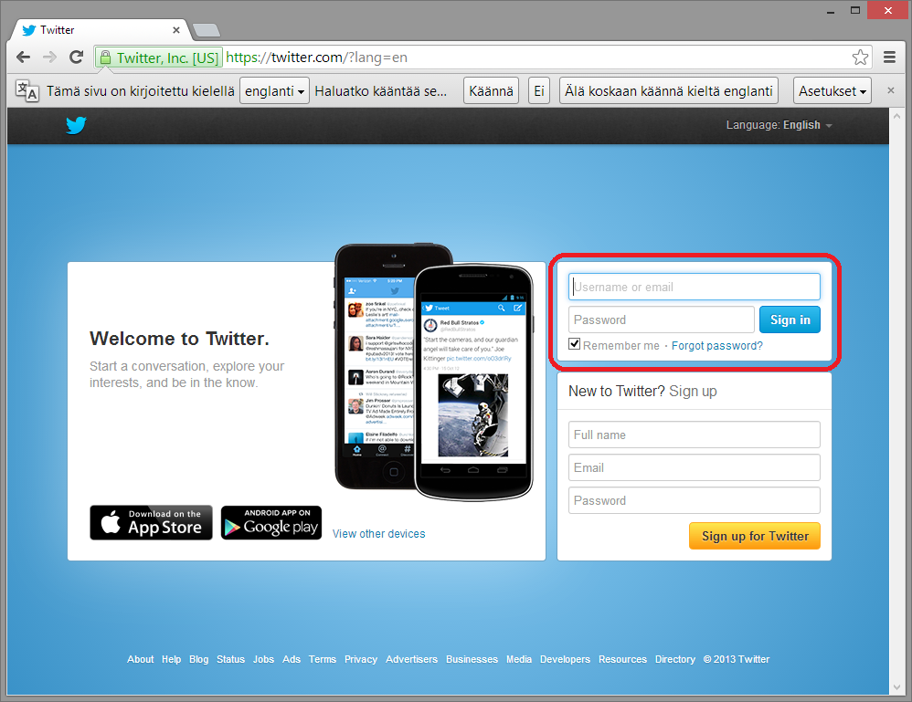
Page Objects

Slide 8
Page Objects

Slide 9
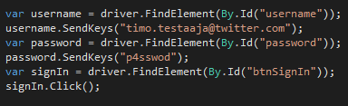
Page Objects

Slide 10

Page Objects

Slide 11
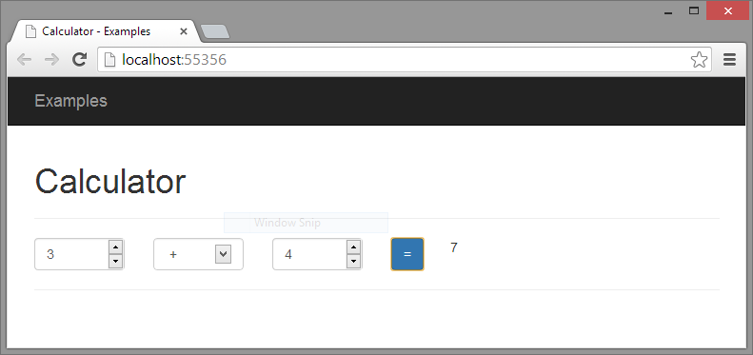
Example, The Calculator

Slide 12
Thank you!

